Slide 1

Welcome to Hostos Community College!
These pages give you an overview of how to access your financial aid and billing information in CUNYfirst. All our communications to you regarding finances will be in CUNYfirst so it is essential that you take time to learn how to use this system.
CUNYfirst Financial Services Guide
  Student Responsibilities
Student Self Service Center
Financial Aid
  View and accept your award
  Essential ‘to do’ list
  Supplemental Form
Bursar/ Financials
  Your account balance
  Direct Deposit
  Tuition payment plan

Slide 2

Student’s Responsibilities
The student is responsible for the tuition amount that is not covered by Financial Aid.
Students should view the deadline for full tuition payment to avoid their classes being dropped.
Students should adhere to the academic calendar deadlines and be aware of the refund policy
NOTE: During “Change of Program Week” all changes must be done with “SWAP” function. A Drop/Add will incur a financial liability.
Student MUST DROP any classes that they no longer wish to attend before the first day of class to avoid incurring any financial liability.

Slide 3
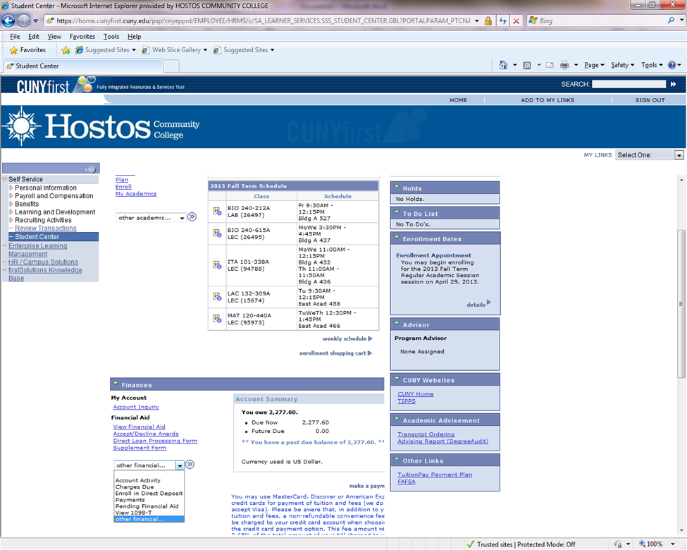
Student Center Self Service Home Screen

Slide 4
Available Options from Home Screen
Class Listing
Holds (top right)
To Do List (middle right)
Account Activity
Pending Financial Aid
Link to Sallie Mae Payment Plan (bottom right)
Direct Deposit

Slide 5

Checking my Financial Aid status online in CUNYfirst
Log on to your CUNYfirst account (www.hostos.cuny.edu/first) click on:
  Self Service
  Student Center
  (Box on the right) View your “To Do List" box.
The “to do list” will show you if there are any other required items/steps needed to complete your Financial Aid process.
If you have any items listed on your “to do list”, click on
  “details”.
  Each “to do” item will have its own link. Click to see further instructions.

Slide 6
Viewing Your Award
If you do not have any items on your “to do list”, scroll down to the “Finances” section:
View financial aid.
Select 2014 to view awards for the Fall 2013 – Spring 2014 academic year.
NOTE: The awards shown represent full-time enrollment. If you change your enrollment from Full to Part-time, your financial aid will be recalculated. You will be able to view the changes by the following day.
If you wish to view what the new awards will be, locate your Expected Family Contribution (EFC) # by using the web address below:
èhttp://www.hostos.cuny.edu/ofa/print/msc/PellSchedule_1314.pdf to view the 2013 -2014 PELL award chart.

Slide 7
Accepting Your Award
Federal Work study and Perkin Loans must be manually accepted to be received. To accept the awards (on the student center page):
Accept/Decline Awards
Select Aid Year 2014 (Financial Aid Year 2013-2014)
On the Award Package page:
ACCEPT FEDERAL WORK STUDY FALL/SPRING
  Submit
  Confirm

Slide 8
Complete a “Supplement Form”
Student Self Service Center Page
Student Center
(In the “Finances” section) Supplement Form
For Institution: Click on the magnifying glass
Under “search results” select the Academic institution you will attend. You may also enter “HOS01” in the box.
For Aid Year: Click on the magnifying glass
Under “search results” select the Academic Year you will attend (2014 represents the Fall 2013 - Spring 2014 academic year).
Ok, Complete the displayed online form, do not leave any questions blank/unanswered
Click on “submit”.

Slide 9
View Your Bill in Account Activity/Summary

Slide 10
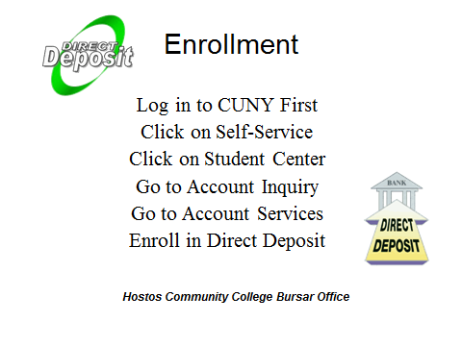
Set up Direct Deposit to Receive your Award Payments
– if you have remaining funds after tuition is paid

Slide 11
Set up a Payment Plan
Tuition Payment Plan for Fall and Spring Semester
Pay tuition a little at a time!
The TuitionPay™ Plan
The TuitionPay Plan from Sallie Mae breaks your tuition bill into smaller, more manageable installments.
  Interest-free payments
  More time to pay
  Convenient, easy online enrollment
  Endorsed by CUNY
  Enroll today to get the most out of your Plan!
Visit www.tuitionpay.com/CUNY to enroll online.
If you would like assistance or have any questions, please call (866) 267-CUNY or contact the Hostos bursar’s Office.

Slide 12
Itemized Detail by term
in Finances section, click down arrow next to “other financial”. Choose account activity.
On next screen, down arrow next to all terms, choose the term and press go.

Slide 13
