Slide 1
COIL AT HOSTOS COMMITTEE
INTRODUCTION

Slide 2
INTRODUCTION TO COLLABORATIVE ONLINE INTERNATIONAL LEARNING
(COIL)

Slide 3
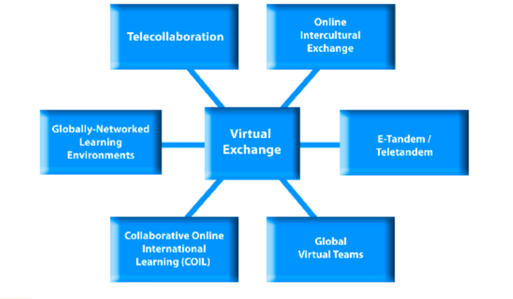
The terms COIL and Virtual Exchange are used interchangeably
From Robert O’Dowd, From Telecollaboration to Virtual Exchange

Slide 4
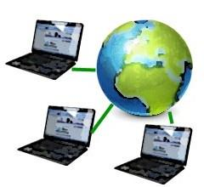
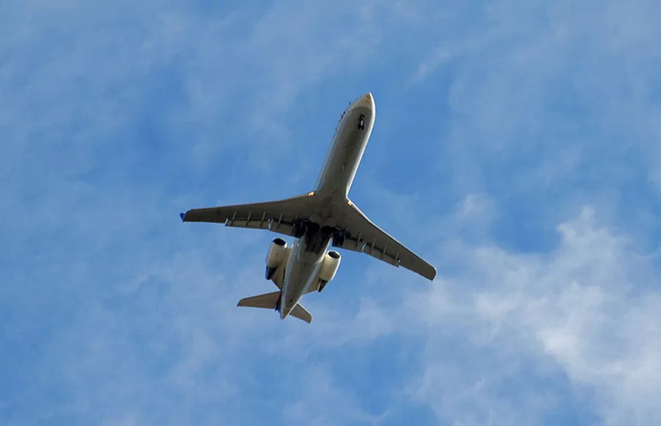
Why is COIL needed?
Ease of transportation
Technology and digital learning are essential skills
Globalization
Global economy
Pandemic demonstrated that global collaboration is need to solve crises
Notes:
Amy

Slide 5
Students will obtain the following competencies:

Slide 6
COIL Basics
Professors residing in different countries collaborate on designing a shared module and integrate it in their existing courses.
Students from both classes collaborate on the assignments.
COIL projects can be done in online and in-person classes.
COIL project/assignments can be synchronous, asynchronous, or hybrid.
The technology used to facilitate the collaboration does not need to be complex.
Course A
Same or different discipline
Same or different language
Professor collaboration
---------------------------------
Design, development
Course B
Same or different discipline
Same or different language
COIL Module
Student collaboration
---------------------------------
Discussions, project
COIL Module
Credit given in Course A
Credit given in Course B
From SUNY COIL

Slide 7
Hostos COIL initiative is new!
This is your chance to become part of a new community!
Support can come from the larger the COIL Committee at Hostos and the faculty fellows of the GSACS (Stevens Initiative grant) program,
Notes:
Amy

Slide 8
Benefits of COIL
Students | Faculty | Institution
Access to global and digital learning | Creates a high impact learning environment | Cutting-edge faculty
Deeper self awareness and ownership in cross-cultural context | Develops innovative and collaborative teaching practice-cutting edge | Increased student engagement-recruitment
Active engagement with global issues-learning different perspectives | Publication/presentation/grants opportunities | Increased faculty publication/grant rate
Opportunity to construct knowledge across difference | International connections with colleagues | International student recruitment
Readiness for globalized workforce-ability to communicate with global audience via digital means | Opportunities to learn about teaching styles and curricula in other countries | High visibility locally and internationally
Notes:
Amy

Slide 9
Stevens Initiative Grant: GSACS Program Overview 2021-2023
Student participants
Faculty facilitators
Collaborate with international peers synchronously and asynchronously
Explore a UN SDG with industry experts from the US and MENA
Engage in experiential project-based learning with international peers
Present their work at a virtual student-led conference
Participate in career development workshops to reflect on and articulate how participation in GSACS builds career-readiness
Form bi-national teams
Attend 10 hours of professional development workshops during Summer 2021 or 2022
Spend 15-20 hours working together to develop a virtual exchange module on a UN SDG
Implement the virtual exchange module in a credit-bearing course
Fall (September-December) or
Spring (February - June)

Slide 10
HOW TO LOCATE A COIL PARTNER!!
COIL/Virtual Exchange Platforms
Unicollaboration.org: “Finding a Virtual Exchange Partner” Sample projects: https://www.unicollaboration.org/index.php/sample-projects/
Unicollaboration partner profile template
Erasmus+ virtual exchange training and fair: https://europa.eu/youth/erasmusvirtual/activity/training-develop-virtual-exchange-projects_en
World Council On Intercultural and Global Competence: https://iccglobal.org/
COIL Connect
Use your own personal/professional networks
Tap into existing campus international partnerships
Use existing CUNY COIL resources
CUNY COIL Academic Commons
Campus COIL Liaison
WC2
Notes:
Amy

Slide 11
Please join the CUNY COIL COMMONS:
https://commons.gc.cuny.edu/groups/collaborative-online-international-learning-coil/
Consult with your Chair and/or Coordinator
Contact Amy Ramson- aramson@hostos.cuny.edu
Identify a course within which you would like to incorporate COIL (think of a project related to your curriculum)
Prepare a partner profile

