Slide 1
Radiation Protection
Pre-Clinical

Slide 2
What Are X-rays?
A form of ionizing radiation
Ionizing radiation is radiation that produces positively and negatively charged particles (ions) when passing through matter.
The production of these ions is the event that may cause injury in normal biologic tissue.

Slide 3
Goals of Radiation Protection
Protect persons from both short-term and long-term effects of radiation.

Slide 4
Concept of Radiation Protection
Ongoing responsibility of diagnostic imaging professionals to ensure radiation safety during all medical radiation procedures
Obligation is fulfilled by adhering to an established radiation protection program.

Slide 5
Radiation Protection
Effective measures employed by radiation workers to safeguard patients, personnel, and the general public from unnecessary exposure to ionizing radiation.
Unnecessary radiation
Any radiation exposure that does not benefit a person in terms of diagnostic information obtained for the clinical management of medical needs.
Any radiation exposure that does not enhance the quality of the study.

Slide 6
Introduction to Radiation Quantities and Units of Measure
Exposure: amount of radiation produced in air when ionizing radiation is present. Measured in coulomb per kilogram [C/kg], or milliroentgen [mR]
Absorbed dose: the amount of energy that is deposited in a material per unit mass of the material. Measured in milligray [mGy].
Effective dose: a quantity that is a measure of general harm in humans. Measured in millisievert [mSv].

Slide 7
Need to Safeguard Against Adverse Biologic Effects of Ionizing Radiation
Based on evidence of harmful biologic effects
Damage to living tissue of animals and humans exposed to radiation

Slide 8
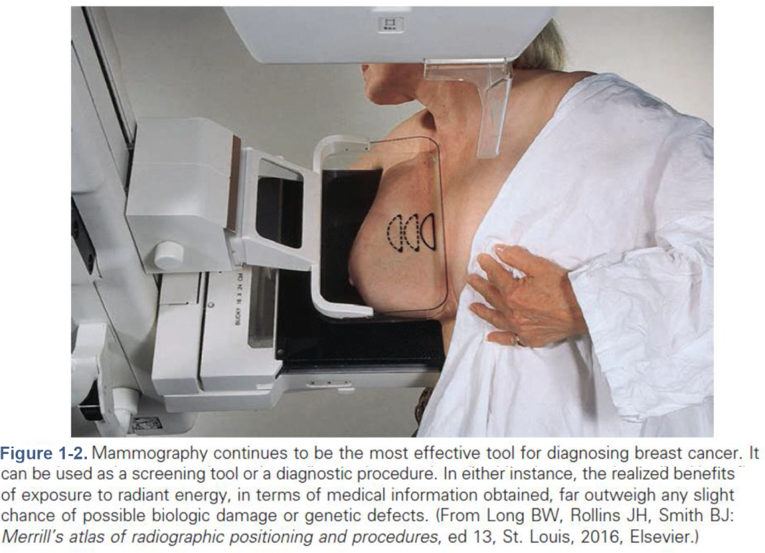
Justification and Responsibility for Imaging Procedures
Benefit versus risk
Patient can elect to assume the relatively small risk of exposure to ionizing radiation.
To obtain essential diagnostic medical information when illness or injury occurs.
When a specific imaging procedure for health screening purposes is prudent.
Example: When women elect to undergo screening mammography to detect breast cancer in its early stages.

Slide 9
Diagnostic Efficacy
The degree to which the diagnostic study accurately reveals the presence or absence of disease in the patient.
Maximized when essential images are produced under recommended radiation protection guidelines
Provides the basis for determining whether an imaging procedure or practice is justified

Slide 10
ALARA Concept
The best way for radiologists and radiographers to do this is to conscientiously employ all appropriate radiation-control procedures, such as
Whenever applicable, applying the basic principles of time, distance, and shielding
Always adequately collimating the radiographic beam
Because continual use of such radiation protection awareness procedures ensures a high degree of safety from most radiation exposure, radiography is not considered a hazardous profession.

Slide 11
As Low as Reasonably Achievable (ALARA) Principle
An acronym for as low as reasonably achievable
Synonymous with the term optimization for radiation protection (ORP)
Intention behind these concepts of radiologic practice is to keep radiation exposure and consequent dose to the lowest possible level.

Slide 12
Cardinal Rules of Radiation Protection
The three basic principles of radiation protection
Time
Distance
Shielding
These principles can be applied to the
Patient
Radiographer

Slide 13
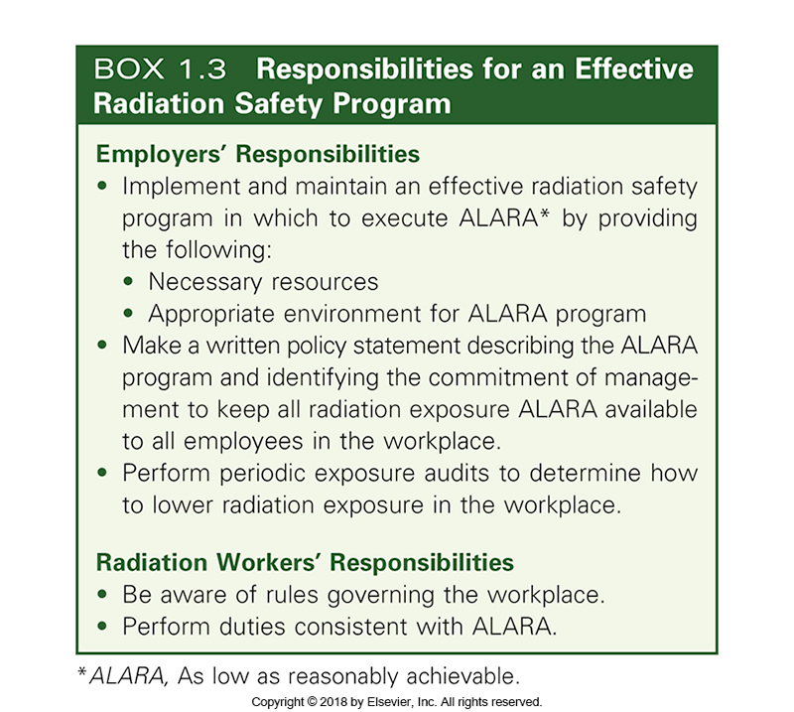
Responsibility for Maintaining ALARA in the Medical Industry

Slide 14
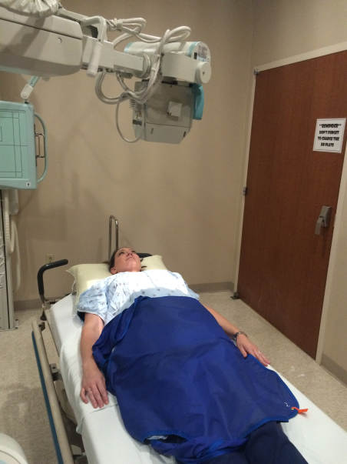
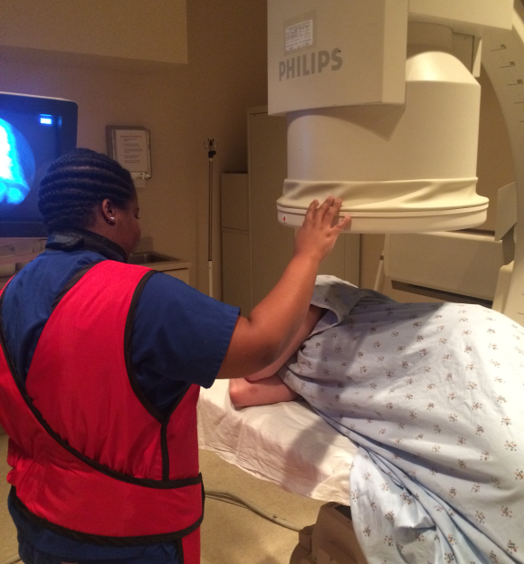
Patient Protection and Patient Education
Educating patients about imaging procedures helps to ensure the highest quality of service.
Use appropriate and effective communication.
Answer questions about the potential risk of radiation exposure honestly
Inform patients of what needs to be done, if anything, as a follow-up to their examination
Figure 1-4. (A) Patient protection. (B) Radiographer protection. Medical radiation exposure should always be kept as low as reasonably achievable (ALARA) for the patient and for imaging personnel.

Slide 15
Risk of Imaging Procedure Versus Potential Benefit
Risk (in general terms)
The probability of injury, ailment, or death resulting from an activity
Risk (in the medical industry) with reference to the radiation sciences
The possibility of inducing a radiogenic cancer or genetic defect after irradiation
Willingness to accept risk
Perception that the potential benefit to be obtained is greater than the risk involved.

Slide 16
Background Equivalent Radiation Time (BERT)
A method that can be used to improve understanding and reduce fear and anxiety for the patient.
Compares the amount of radiation received with natural background radiation received over a given period of time (see Table 1-1 in textbook)
Based on an annual U.S. population exposure of approximately 3 mSv per year

Slide 17
Advantages of the BERT Method When It Is Used Appropriately
BERT does not imply radiation risk; it is simply a means for comparison.
BERT emphasizes that radiation is an innate part of our environment.
The answer given in terms of BERT is easy for the patient to comprehend.

Slide 18
Increased Radiation Sensitivity of Children
Children are significantly more radiation sensitive than are adults.
Studies have shown that the more radiation exposure a child receives the more likely for them to develop cancer later in life.

Slide 19
Annual Limit for Occupationally Exposed Personnel (Cont.)
Allowance for a larger EqD for radiation workers
Valid reasons exist for allowance of a larger EqD for radiation workers.
The workforce in radiation-related jobs is small when compared with the population as a whole.
The amount of radiation received by this workforce can be larger than the amount received by the general public without alteration in the genetically significant dose (GSD).
Although the radiographer and other diagnostic imaging personnel are allowed to absorb more radiation, the EqD received must be minimized whenever possible to reduce the potential for
Somatic damage
Genetic damage

Slide 20
Personnel Monitoring
Requirement for personnel monitoring
Personnel dosimetry—the monitoring of equivalent dose to any person occupationally exposed on a regular basis to ionizing radiation.
Ensure that occupational radiation exposure levels are kept well below annual effective dose (EfD) limits
Create awareness of various radiation exposure monitoring devices and their functions

Slide 21
Dose-Reduction Methods and Techniques
Avoiding repeat imaging
Eliminate additional exposure
The patient as a source of scattered radiation
During a diagnostic examination, the patient becomes a source of scattered radiation as a consequence of the Compton interaction process.
At a 90-degree angle to the primary x-ray beam at a distance of 1 m, the scattered x-ray intensity is generally approximately 1/1000 of the intensity of the primary x-ray beam.

Slide 22
Dose-Reduction Methods and Techniques (Cont.)
Scattered radiation: occupational hazard
Scattered radiation poses the greatest occupational hazard in diagnostic radiology
Use of any device or appropriate technique that lessens the amount of scattered radiation significantly reduces occupational exposure of diagnostic imaging personnel

Slide 23
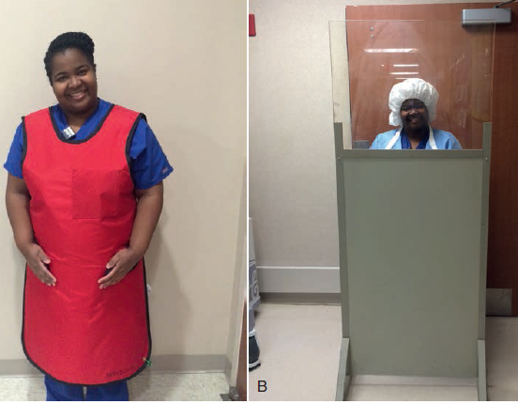
Dose-Reduction Methods and Techniques (Cont.)
Filtration of the diagnostic x-ray beam
Removes nonuseful low-energy photons from the primary beam; filtration primarily benefits the patient
Without proper filtration, more nonuseful low-energy photons would interact with the patient’s body, increasing scatter that could possibly cause an increase in the radiographer’s EqD
Protective Apparel
Figure 14-2. (A) A lead apron protects occupationally exposed personnel from scattered radiation. (B) A lead mobile x-ray barrier of 0.5- or 1.0-mm lead equivalent provides protection from scattered radiation. It may be used during special procedures, in the operating room, and in cardiac units.

Slide 24
Dose-Reduction Methods and Techniques (Cont.)
Protective apparel (cont.)
Lead aprons and shielded barriers function as gonadal shields for diagnostic imaging personnel.
Protect personnel from secondary (scatter and leakage) radiation.
Available in various thicknesses of lead such as: 0.25 (minimum), 0.5 (standard), and 1 mm. 0.5 lead equivalent is standard for fluoroscopy.
Higher lead equivalency provides greater protection from radiation, but the garment will weigh more.
Wrap-around style apron would afford the best protection.
Requires special care to prevent damage

Slide 25
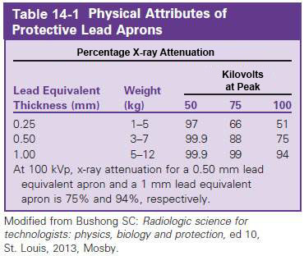
Dose-Reduction Methods and Techniques (Cont.)

Slide 26
Dose-Reduction Methods and Techniques (Cont.)
Technical exposure factors
Influence the quantity of scattered radiation produced and reaching imaging personnel
Use of higher kVp, increasing mean energy of photons in the radiographic beam, and lower mAs, decreasing photon beam intensity
As average energy of the beam increases, the percentage of radiation that is forward-scattered increases. Therefore, less side scattered radiation is available to strike imaging personnel, and their EqD is reduced.
Use of high-speed image receptor systems
Requiring smaller radiographic exposure (less ma), fewer photons are available to produce compton scatter, decreasing personnel exposure

Slide 27
Dose-Reduction Methods and Techniques (Cont.)
Repeats in digital imaging
Almost all repeats as a result of improper technique selection are eliminated because the image contrast and overall brightness can be manipulated after image acquisition.
Repeats necessitated by mispositioning can still occur, resulting in the possibility of a repeat examination that can cause additional radiation exposure for both the patient and the technologist.

Slide 28
Dose-Reduction Methods and Techniques (Cont.)
Patient Restraint
Radiographers should never stand in the primary (useful) beam to restrain a patient during a radiographic exposure.
Use mechanical restraining devices whenever possible when patient restraint is necessary
If restraint by people is necessary, select nonoccupationally exposed persons wearing appropriate protective apparel and position so that their lead-protected torsos are not struck by the primary, or direct, beam.
Pregnant women are never to be permitted to assist in holding a patient during an exposure.

Slide 29
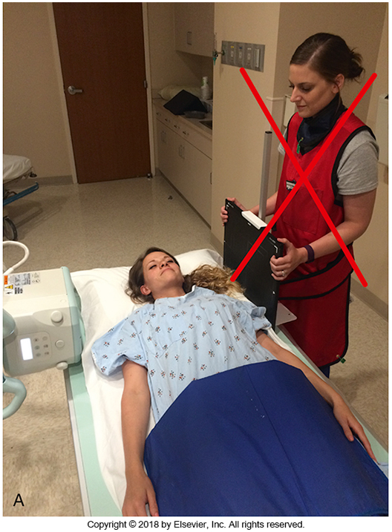
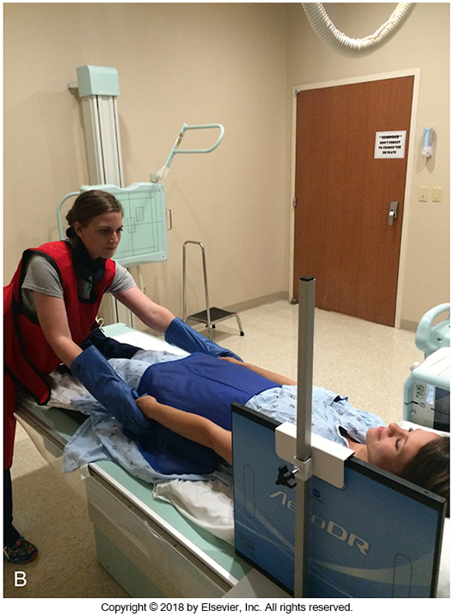
Patient Restraint
Figure 14-3 (A) The radiographer should never stand in the primary (useful) beam to restrain the patient. (B) A nonoccupationally exposed person restraining a patient during a radiographic exposure should wear a lead apron, gloves, and thyroid shield and stand outside the primary beam.

Slide 30
Protection for Pregnant Personnel
Imaging department protocol
Pregnant personnel should be able to continue performing their duties without interruption of employment if they follow established radiation safety practices.
Policies for protecting pregnant personnel from radiation
Voluntary “declaration” of the pregnancy
Health care facility officially recognizes the pregnancy.

Slide 32
Personnel Monitoring (Cont.)
Required whenever radiation workers are likely to risk receiving 10% or more of the annual occupational EfD limit of 50 mSv (5 rem) in any single year as a consequence of their work-related activities
In keeping with the as low as reasonably achievable (ALARA) concept, most health care facilities issue dosimetry devices when personnel could receive approximately 1% of their annual occupational EfD limit in any month, or approximately 0.05 mSv (50 mrem).

Slide 33
Purpose of Personnel Dosimeter
Provides an indication of the working habits and working conditions of diagnostic imaging personnel
Determines occupational exposure by detecting and measuring the quantity of ionizing radiation to which the dosimeter has been exposed over a period of time
Does not protect the wearer from exposure; only capable of detecting and measuring ionizing radiation

Slide 34
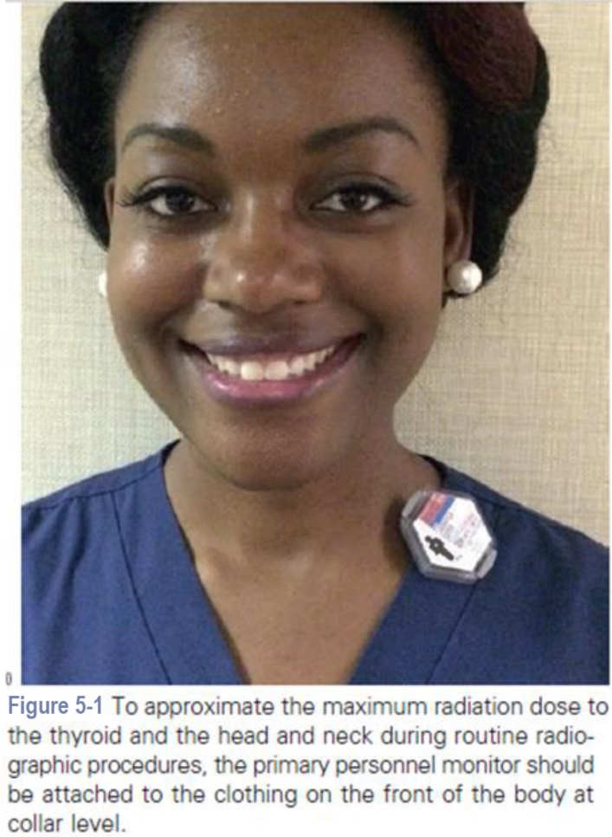
Placement of Personnel Dosimeter
During routine computed radiography, digital radiography, or conventional radiographic procedures
When a protective apron is not being worn, primary personnel dosimeter should be attached to the clothing on the front of the body at collar level.
When a protective apron is used, dosimeter should be worn outside the apron at collar level on the anterior surface of the body.

Slide 35
Placement of Personnel Dosimeter as a Second Monitor
When a protective apron is worn, the first, or primary, dosimeter is to be worn outside the protective apparel at collar level.
The second dosimeter should be worn beneath a wraparound-style lead apron at waist level.

Slide 36
Placement of a Personnel Dosimeter as a Monitor for the Embryo–Fetus
For pregnant diagnostic imaging personnel
Primary dosimeter is worn at collar level.
Second monitoring device is worn at abdominal level.

Slide 37
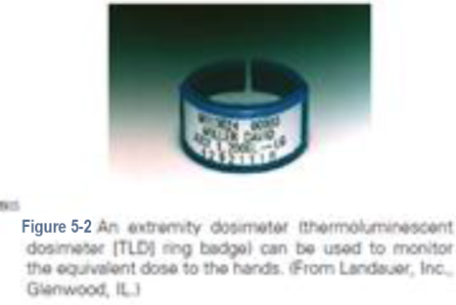
Extremity Dosimeter
A thermoluminescent dosimeter (TLD) ring badge is worn as a second monitor when performing radiographic procedures that require the hands to be near the primary x-ray beam.
Purpose of the extremity dosimeter
Laser-etched cover contains identification
Reusable TLD element of the dosimeter

Slide 38
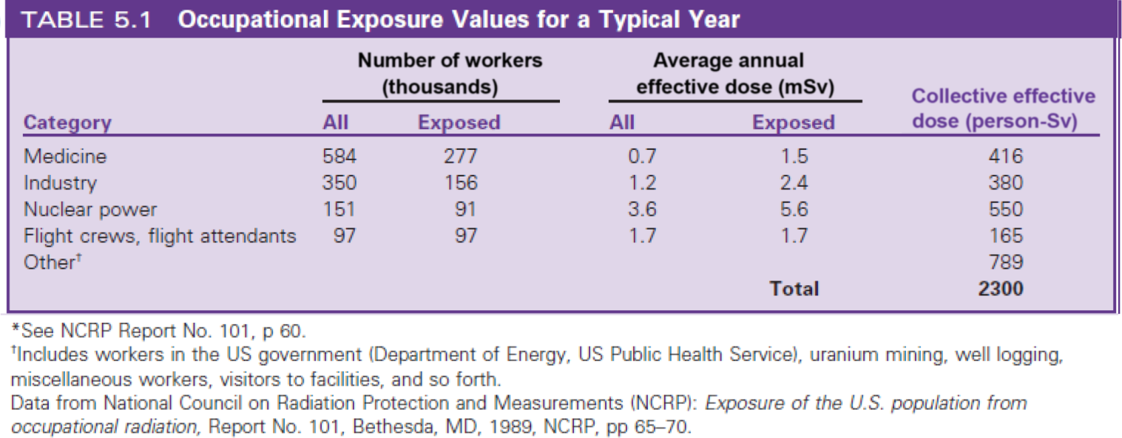
Record of Radiation Exposure
Should be part of the employment record of all radiation workers
Values represent the average annual EfD to the whole body

Slide 39
Personnel Dosimeters
Characteristics
Lightweight and easy to carry
Made of materials durable enough to tolerate normal daily use
Able to detect and record both small and large exposures in a consistent and reliable manner
Outside influences should not affect performance of the instrument
Should be reasonably inexpensive to purchase and maintain
Permit health care facilities to use large numbers of monitors in a cost-effective manner

Slide 40
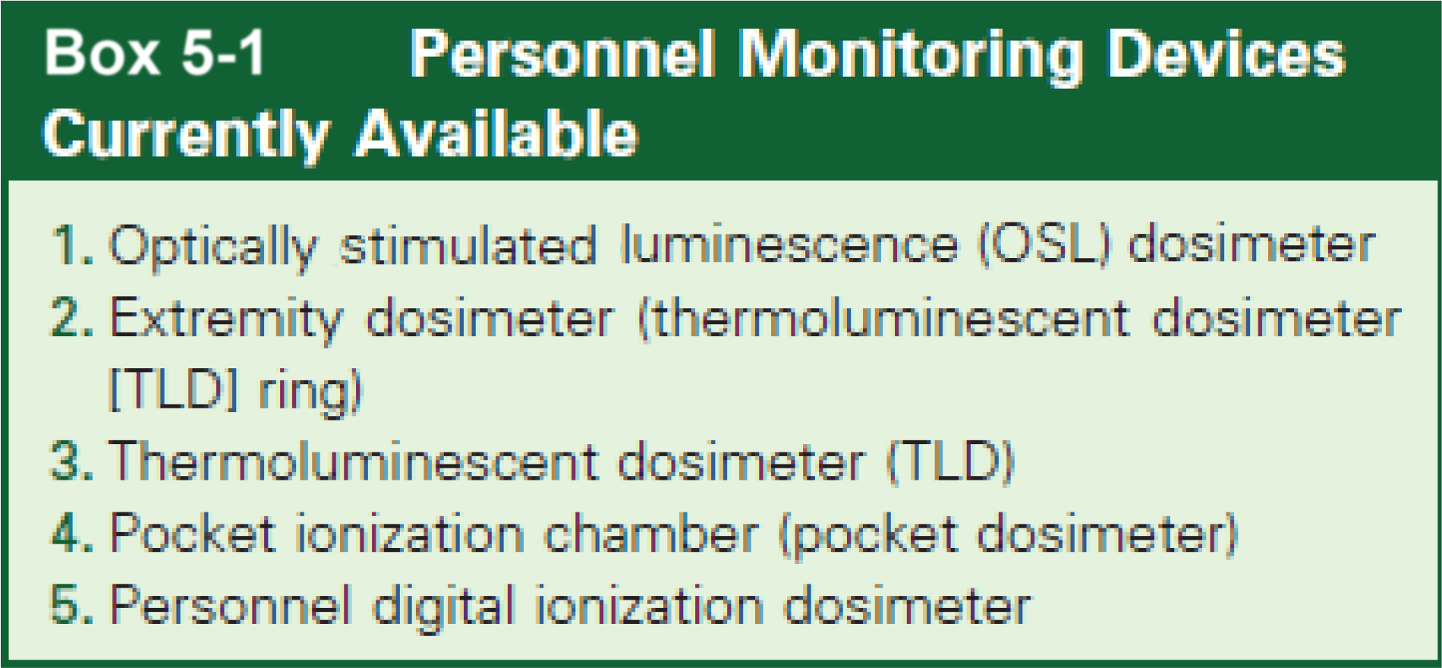
Personnel Monitoring Devices Currently Available

Slide 41
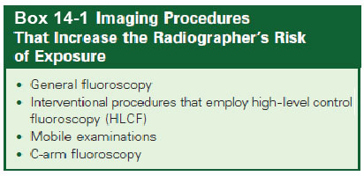
Reducing Exposure for Imaging Personnel During Diagnostic X-Ray Procedures
Some procedures increase the radiographer’s risk of exposure because of scatter radiation.

Slide 42
Annual Limit for Occupationally Exposed Personnel
Effective dose (EfD) limits
Federal government standards, following a recommendation of the NCRP, permit diagnostic imaging personnel to receive an “annual occupational EfD of 50 mSv” for whole-body exposure during routine operations.
However, in keeping with ALARA and diligent supervision of personnel cumulative radiation exposure records, no radiographer should ever approach this effective dose level.

Slide 43
Annual Limit for Occupationally Exposed Personnel (Cont.)
EfD does not include
Personal medical exposure
Natural background exposure
Lifetime EfD in millisieverts should not exceed 10 times the person’s age in years.
A cumulative EfD (CumEfD) limit has been established for the whole body that limits a radiation worker’s lifetime effective dose to his or her age in years times 10 mSv.

Slide 44
Annual Limit for Occupationally Exposed Personnel (Cont.)
Annual occupational and nonoccupational EfD limits
Annual occupational EfD limit of 50 mSv
Annual limit for members of the general population is 1 mSv for continuous or frequent exposure from artificial sources other than medical irradiation and natural background radiation and 5 mSv for infrequent annual exposure.
Limitation of exposure of the general public to a reasonable level of risk comparable with risks from other common sources

Slide 45
Protection for Pregnant Personnel (Cont.)
Imaging department protocol (Cont.)
Facility, through its RSO, provides counseling and furnishes an additional monitor to be worn at waist level during all radiation procedures.
When a protective lead apron is worn, the additional monitor should be worn at waist level beneath the garment.
Purpose: To ensure that the monthly EqD to the embryo–fetus does not exceed 0.5 mSv or a limit of 5.0 mSv during the entire pregnancy.
EqD limit is designed to significantly restrict the total lifetime risk of leukemia and other malignancies in persons exposed in utero.

Slide 46
Protection for Pregnant Personnel (Cont.)
Acknowledgment of counseling and understanding of radiation safety measures
After receiving radiation safety counseling, the pregnant radiologic technologist must read and sign a form acknowledging that she has received counseling and understands the practices to be followed to ensure the safety of the embryo–fetus.
Dosimeter companies provide a separate monthly report that tracks the exposure of the worker and the embryo–fetus.

Slide 47
Protection for Pregnant Personnel (Cont.)
Protective maternity apparel should be available.
Maternity protective aprons consist of 0.5-mm lead equivalent over the entire length and width and also have an extra 1-mm lead equivalent protective panel that runs transversely across the width of the apron to provide added safety for the embryo–fetus.
Wraparound protective aprons of 0.5-mm lead equivalent can also be used during pregnancy.

Slide 48
Protection for Pregnant Personnel (Cont.)
Work schedule alteration
In accordance with ALARA guidelines, work schedules are designed to distribute radiation exposure risk evenly to all employees.
Other unknowingly potentially pregnant radiographers can be subject to increased risk if a declared pregnant radiographer is reassigned to a lower radiation exposure risk area.
A declared pregnant radiographer does not necessarily need to be reassigned to a lower radiation exposure as a consequence of a declared pregnancy.
EqD to the embryo–fetus from occupational exposure of the mother need not exceed the NCRP recommended monthly EqD limit of 0.5 mSv or a limit or 5.0 mSv during the entire pregnancy.

Slide 49
Basic Principles of Radiation Protection for Personnel Exposure Reduction
Occupational radiation exposure of imaging personnel can be minimized by the use of three cardinal principles: time, distance, and shielding.
Time: Decreasing the length of time spent in a room where x-radiation is being produced
Distance: Standing at the greatest distance possible from an energized x-ray beam
Shielding: Interposing a radiation-absorbent shielding material between the radiation worker and the source of radiation

Slide 50
Basic Principles of Radiation Protection for Personnel Exposure Reduction (Cont.)
Time
The amount of radiation a worker receives is directly proportional to the length of time for which the individual is in the path of ionizing radiation.
Most fluoroscopic x-ray equipment have 5-minute timers to alert the radiologist or other authorized equipment operator that a specific period of time has elapsed.
Radiographers should be present in a fluoroscopic room only when needed to perform relevant patient care and to fulfill respective duties associated with the procedure. Otherwise, the radiographer should remain behind a protective barrier.

Slide 51
Basic Principles of Radiation Protection for Personnel Exposure Reduction (Cont.)
Distance
Most effective means of protection from ionizing radiation
Imaging personnel receive significantly less radiation exposure by standing farther away from a radiation source.
Application of the Inverse Square Law (ISL)
ISL expresses the relationship between distance and intensity (quantity) of radiation and governs the dose received.
Law: “The intensity of radiation is inversely proportional to the square of the distance from the source.”

Slide 52
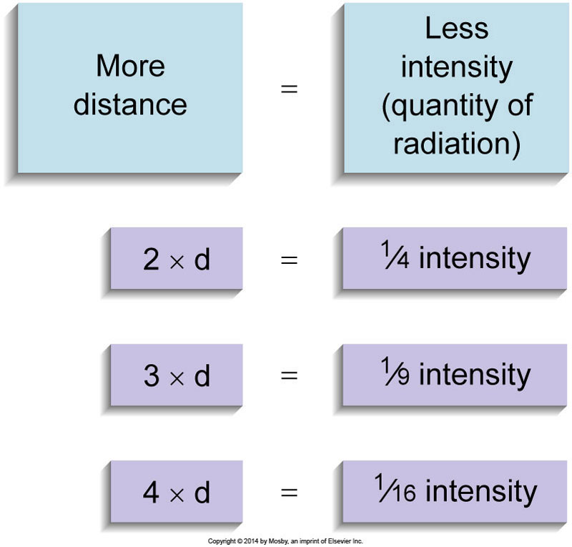
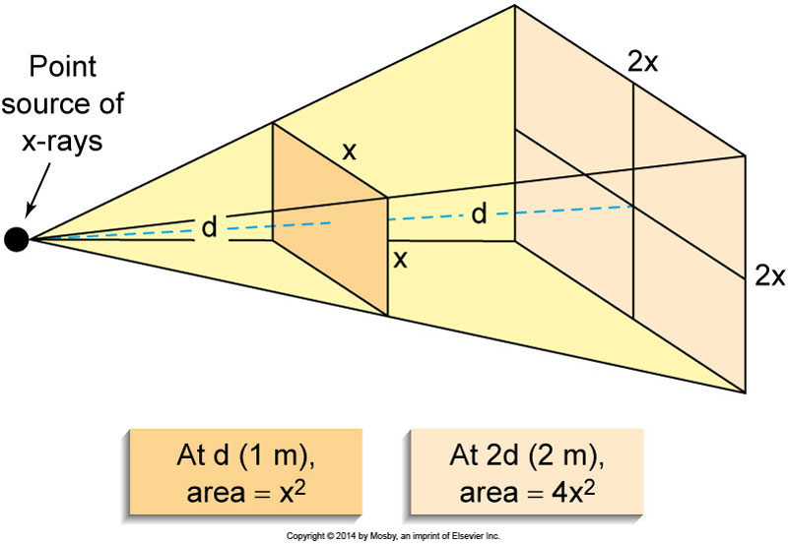
Basic Principles of Radiation Protection for Personnel Exposure Reduction (Cont.)
Distance
Distance
Figure 14-4. As the distance between the source of radiation and any given measurement point increases, radiation intensity (quantity) measured at that point decreases by the square of the relative change in distance between the new location and the old.
Figure 14-5. When the distance from a point source of radiation is doubled, the radiation at the new location spans an area four times larger than the original area. However, the intensity at the new distance is only one fourth of the original intensity.

Slide 53
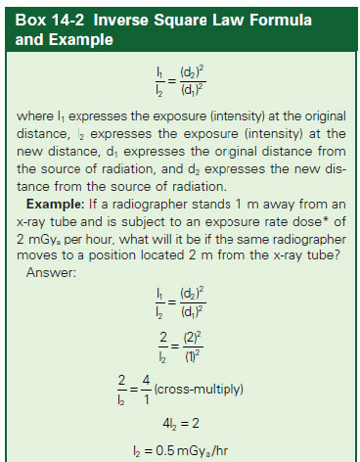
Basic Principles of Radiation Protection for Personnel Exposure Reduction (Cont.)
Distance
The ISL may be stated as a formula
The ISL also implies that if a radiographer moves closer to a source of radiation, the radiation exposure to the radiographer drastically increases.
Example: If the radiographer stands 2 m away from an x-ray source instead of 6 m, the radiographer’s radiation exposure increases by a factor of (6/2)² = 9.

Slide 54
Basic Principles of Radiation Protection for Personnel Exposure Reduction (Cont.)
Shielding
Used when it is not possible to use the principles of time and/or distance to minimize occupational exposure
Protective shielding of appropriate thickness may be used to provide protection from radiation.
Lead and concrete are the most common materials used for structural protective barriers.
Accessory devices such as aprons, gloves, protective eyeglasses, and thyroid shields are made of lead-impregnated vinyl.
Effectiveness of shielding material depends on their:
Atomic number
Density
Thickness

Slide 55
Basic Principles of Radiation Protection for Personnel Exposure Reduction (Cont.)
Shielding (Cont.)
Protective structural shielding
Structural barriers such as walls and doors in an x-ray room have been designed to provide radiation shielding for imaging department personnel and the general public.
Ensures that occupational and nonoccupational annual EfD limits are not exceeded
A qualified medical physicist determines the exact protection requirements for a particular imaging facility.

Slide 56
Basic Principles of Radiation Protection for Personnel Exposure Reduction (Cont.)
Shielding (Cont.)
Primary protective barrier
Purpose: to prevent direct, or unscattered, radiation from reaching personnel or the general public on the other side of the barrier
Location: Perpendicular to the undeflected line of travel of the x-ray beam
Specifications for 120 kvp x-ray beam:
Consists of 1.6 mm (1/16 inch) lead
Extends 2.1 m upward from the floor of the x-ray room when the x-ray tube is 1.5 to 2.1 m (5 to 7 feet) from the wall in question

Slide 57
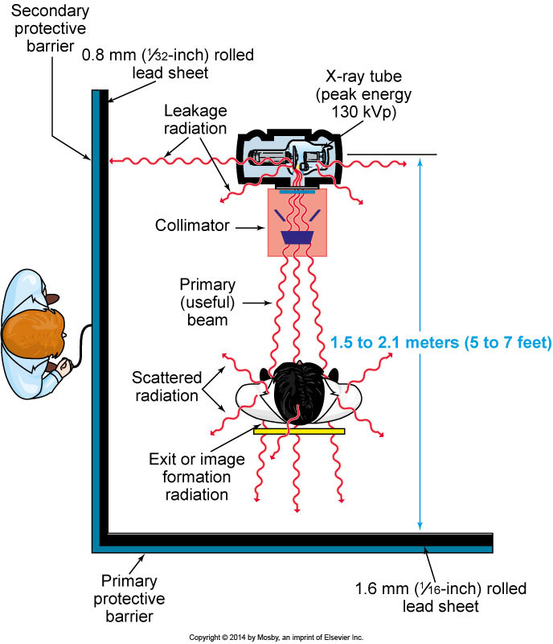
Basic Principles of Radiation Protection for Personnel Exposure Reduction (Cont.)
Figure 14-6. Protective barriers are lined with lead to protect personnel and the general public from radiation. The primary protective barrier is located perpendicular to the undeflected line of travel of the x-ray beam. The walls that are not in the direct line of travel of the primary beam are called secondary protective barriers because they are designed to shield against secondary (leakage and scattered) radiation.

Slide 58
Basic Principles of Radiation Protection for Personnel Exposure Reduction (Cont.)
Shielding (Cont.)
Secondary protective barrier
Purpose: Protects against secondary radiation (leakage and scatter radiation)
Location: Any wall or barrier that is never struck by the primary x-ray beam is classified as a secondary barrier (this does not mean that secondary radiation cannot hit primary barriers as well).
Should overlap the primary protective barrier by approximately 1.27 cm (1/2 inch)
Specifications: Consists of 0.8 mm (1/32-inch) of lead

Slide 59
Basic Principles of Radiation Protection for Personnel Exposure Reduction (Cont.)
Shielding (Cont.)
Secondary protective barrier (Cont.)
Personnel must remain completely behind the barrier.
Observation window in barrier typically consists of 1.5-mm lead equivalent.
Exposure of the radiographer will not exceed a maximum allowance of 1 mSv per week; in a well-designed facility, exposure should not exceed 0.02 mSv per week.
Exposure cord must be short enough that the exposure switch can be operated only when the radiographer is completely behind the control-booth barrier.

Slide 60
Basic Principles of Radiation Protection for Personnel Exposure Reduction (Cont.)
Shielding (Cont.)
Control-booth barrier
Purpose: To protect the radiographer from secondary radiation (leakage and scatter)
Location: In x-ray rooms housing permanent or nonportable radiographic equipment
Specifications
Must extend 2.1 m upward from the floor
Must be permanently secured to the floor
Diagnostic x-rays should scatter a minimum of two times before reaching any area behind this barrier.

Slide 61
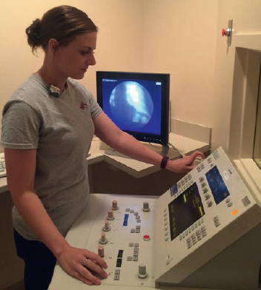
Basic Principles of Radiation Protection for Personnel Exposure Reduction (Cont.)
Figure 14-7. While making a radiographic exposure with a stationary radiographic unit, the radiographer must remain completely within the control-booth barrier (behind the fixed protective barrier) for safety. The radiographer may observe the patient through the lead glass observation window in the control booth.
Figure 14-8. A clear lead-acrylic secondary protective barrier impregnated with approximately 30% lead lends a modern appearance to the facility.

Slide 62
Basic Principles of Radiation Protection for Personnel Exposure Reduction (Cont.)
Shielding
Clear lead-acrylic secondary protective barrier
Contains clear lead-acrylic material impregnated with approximately 30% lead by weight
Permits a panoramic view, allowing diagnostic imaging personnel to observe the patient more completely
Modular x-ray barriers are
Shatter resistant
Can extend 2.1 m (7 feet) upward from the floor
Available in lead equivalency from 0.3 to 2 mm

Slide 63
Basic Principles of Radiation Protection for Personnel Exposure Reduction (Cont.)
Shielding (Cont.)
Clear lead-acrylic overhead protective barrier
Can be used as overhead x-ray barrier to provide an open view during special procedures and cardiac catheterization
Shielding typically offers 0.5-mm lead equivalency protection

Slide 64
Basic Principles of Radiation Protection for Personnel Exposure Reduction (Cont.)
Shielding (Cont.)
Accessory protective devices
Aprons
Physical weight concerns
Garments impregnated with tin
For 100 kVp, apron must be equivalent to at least 0.25-mm thickness of lead
0.5- or 1-mm lead equivalent afford much greater protection
0.5-mm lead equivalent is the most widely recommended thickness in diagnostic imaging

Slide 65
Basic Principles of Radiation Protection for Personnel Exposure Reduction (Cont.)
Shielding (Cont.)
Accessory protective devices (cont.)
Gloves
0.25-mm lead equivalent is most widely used
Thyroid shields
Neck and thyroid shield can guard the thyroid area during general fluoroscopy and x-ray special procedures.
It should be a minimum of 0.5-mm lead equivalent.
Protective eyeglasses
Can reduce scatter radiation to the lens of the eye
Lenses contain a minimal lead equivalent protective level of 0.35 mm.

Slide 66
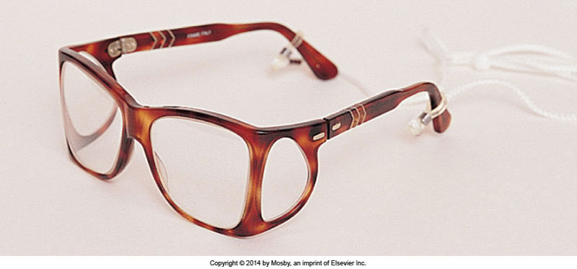
Basic Principles of Radiation Protection for Personnel Exposure Reduction (Cont.)
Figure 14-12. Eyeglasses protect the lens of the eyes during general fluoroscopy and special procedures. (Shown are glasses with wraparound frames; other styles are also available.)

Slide 67
X-ray Tube Housing Cables
Radiographers should avoid handling or severely bending the high-tension cables that are connected to the + and – terminals of the x-ray tube.
Do not touch the tube housing or high-tension cables while an exposure is in progress.

Slide 68
Protection During Fluoroscopic Procedures
Personnel protection
Radiographer should stand as far away from the patient as is practical and should move closer to the patient only when assistance is required during a fluoroscopic examination to ensure protection from scattered radiation emanating from the patient.
Wear protective apron of at least 0.5-mm lead equivalent
Wear protective gloves of at least 0.25-mm lead equivalent whenever the hands must be placed near the fluoroscopic field
Wear thyroid shield of 0.5-mm lead equivalent
When the radiographer’s assistance is not needed, he or she should either stand behind the radiologist, who is also wearing protective apparel, or stand behind the control-booth barrier until his or her services are required.
A wraparound style protective apron may be worn during a fluoroscopic procedure.

Slide 69
Protection During Fluoroscopic Procedures (Cont.)
Dose-reduction techniques
Some methods and devices for dose-reduction during fluoroscopy include
Adequate beam collimation
Adequate filtration
Control of technical exposure factors
Appropriate source-to-skin distance (SSD)
Use of a cumulative timing device
Diagnostic-type protective x-ray tube housing

Slide 70
Protection During Fluoroscopic Procedures (Cont.)
Remote control fluoroscopic systems
Provide imaging personnel the best radiation protection opportunity
System permits radiologist and assisting radiographer to remain outside of the fluoroscopic room at a control console located behind a protective barrier until needed.
Added distance and therefore the ISL are used as a means of increased protection.
Protective curtain
Minimum of 0.25 mm lead equivalent

Slide 71
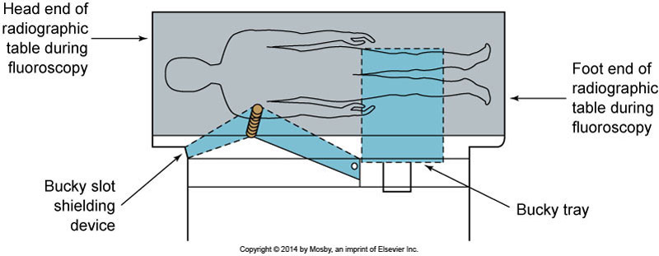
Protection During Fluoroscopic Procedures (Cont.)
Bucky slot shielding device
Of at least 0.25-mm lead equivalent
Must automatically cover the Bucky slot opening in the side of the x-ray table during a standard fluoroscopic examination when the Bucky tray is positioned at the foot end of the table
Protects radiologist and radiographer at gonadal level
Figure 14-15. To provide protection at the gonadal level for the fluoroscopist, the Bucky slot shielding device should be at least 0.25-mm lead equivalent.

Slide 72
Protection During Fluoroscopic Procedures (Cont.)
Rotational scheduling of personnel
Diagnostic imaging personnel who receive the highest occupational exposure during
Fluoroscopy
Mobile radiography
Special procedures
Interventional surgery
Scheduling personnel to spend less time in these higher-radiation tasks can decrease this exposure.
Radiographers may be assigned to clinical areas in a rotational pattern.
Uses the cardinal principle of time as a means of additional radiation protection

Slide 73
Protection During Mobile Radiographic Examinations
Use of protective garments
Suitable protective garments should be worn by the radiographer whenever structural or mobile protective shielding is unavailable.
A protective apron should be assigned to each mobile unit.
Distance as a means of protection
Use a mobile x-ray unit remote control exposure device, if available, to leave the immediate vicinity and use distance as an effective means of protection from radiation whenever possible.
For mobile x-ray units that are nonremote-controlled, the cord leading to the exposure switch must be long enough to permit the radiographer to stand at least 2 m (approximately 6 feet) from the patient, the x-ray tube, and the useful beam (permits use of ISL).

Slide 74
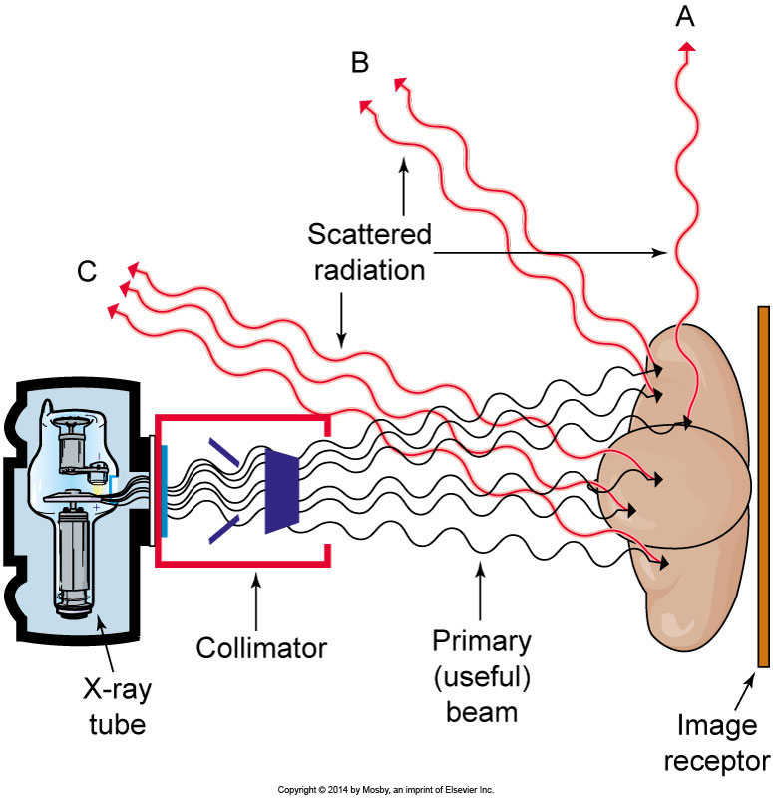
Protection During Mobile Radiographic Examinations (Cont.)
Where the radiographer should stand during a mobile radiographic procedure
Radiographer should attempt to stand at a right angle (90 degrees) to the x-ray beam-scattering object (the patient) line. When protection factors of distance and shielding have been accounted for, this is the place at which the least amount of scattered radiation is received.
Figure 14-16. When the protective factors of distance and shielding have been accounted for, the radiographer will receive the least amount of scattered radiation by standing at a right angle (90 degrees) to the scattering object (the patient) (in position A). The most scattered radiation would be received at point C because of backscatter coming from the patient. (Intensity, or quantity, of x-ray exposure at any given point is indicated in this picture by the number of scattered x-rays reaching that point.)

Slide 75
Protection During C-Arm Fluoroscopy
Personnel exposure from scattered radiation
Radiographers should exercise vigilance during C-arm fluoroscopy because
Patterns of exposure direction are less predictable.
Equipment is frequently operated by physicians whose training and experience in radiation safety may not match those of an experienced radiologist.
Exposure of personnel is caused by scattered radiation from the patient.
The exposure rate caused by scatter near the entrance surface of the patient (the x-ray tube side) exceeds the exposure rate caused by scatter near the exit surface of the patient.
The location of the lower potential scatter dose is on the side of the patient away from the x-ray tube (i.e., the image intensifier side).

Slide 76
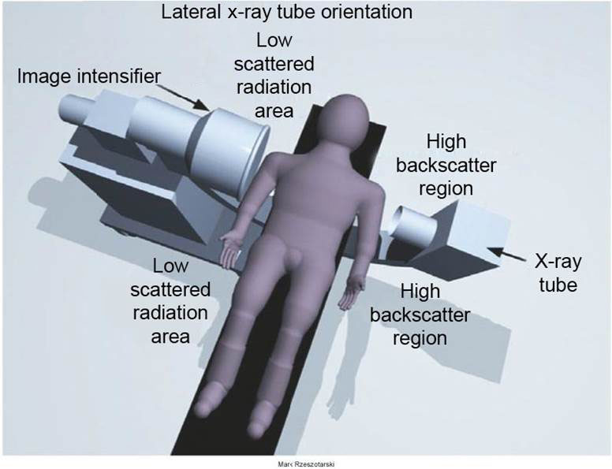
Protection During C-Arm Fluoroscopy (Cont.)
Figure 14-17. Cross-table exposure during use of a C-arm fluoroscope. The exposure rate caused by scatter near the entrance surface of the patient (the x-ray tube side) exceeds the exposure rate caused by scatter near the exit surface of the patient (the image intensifier side). The location of lower potential scatter dose is on the side of the patient away from the x-ray tube (i.e., the image intensifier side). (From Mark Rzeszotarski.)

Slide 77
Protection During C-Arm Fluoroscopy (Cont.)
Need for protective apparel for all personnel and monitoring of imaging personnel
Procedures that require the C-arm unit to be energized for long periods of time, increase radiation exposure.
Personnel that routinely operate a C-arm fluoroscope must wear a lead apron. It should be of 0.5-mm lead equivalent, neck and thyroid shield of 0.5-mm lead equivalent should also be worn.
Appropriate monitoring of imaging personnel is mandatory.
Positioning of the C-arm fluoroscope
For increased radiation safety it is best to place the x-ray tube of the C-arm under the table and the image intensifier over the table.

Slide 78
Protection During C-Arm Fluoroscopy (Cont.)
Exposure reduction for personnel
Minimize beam-on time
Be aware of cumulative timer
Use image storage device (e.g., last image hold)
Position image intensifier end of the C-arm close to the patient
Collimate x-ray beam to the anatomy of interest
Use distance whenever possible
Use the magnification feature sparingly; it should be used only on the request of the physician performing the procedure.

