Slide 1
AES Program Reflection Process - Cohort Meeting #2

Slide 2
Agenda
Time | Agenda Item
3:00 – 3:05 | Welcome and Settling In
3:05 – 3:15 | Debrief Unit Team Discussions
3:15 – 3:20 | Clarity on 2nd Part of the Template Document
3:20 – 3:35 | Pressure Testing Unit Activities Based on Assessment (Group Activity)
3:35 – 3:55 | Workshopping Approach to Seeking External Feedback (Pairs)
3:55 – 4:00 | Next Steps

Slide 3
Recording
Notes:
For the purposes of my learning (I will be the sole viewer)

Slide 4
Meeting Objectives
AES Unit Leaders will . . .
Unpack what worked or didn’t with team discussions to be able to use that information moving forward
Be able to Finalize the 2nd part of template document by collectively pressure-testing preliminary decisions
Have a plan for seeking external feedback

Slide 5
Debrief Unit Team Discussions

Slide 6
Quote
“Assessment has been bastardized into meaning measurement. It’s not the same thing. Assessment is not measurement. I assess my students every single day, but it’s not in what is maybe the conventional sense. Assessment is not a spreadsheet, it’s a conversation.”
Joe Bower
(Late former teacher)
Notes:
https://medium.com/learning-re-imagined/assessment-is-not-a-spreadsheet-its-a-conversation-3d743c754809

Slide 7
Debrief Questions
What worked well? What helped?
If you had the opportunity to do it over again, what might you do differently?

Slide 8
Clarity on 2nd Part of Template Document
Notes:
Go to the Cohort Structure Document

Slide 9
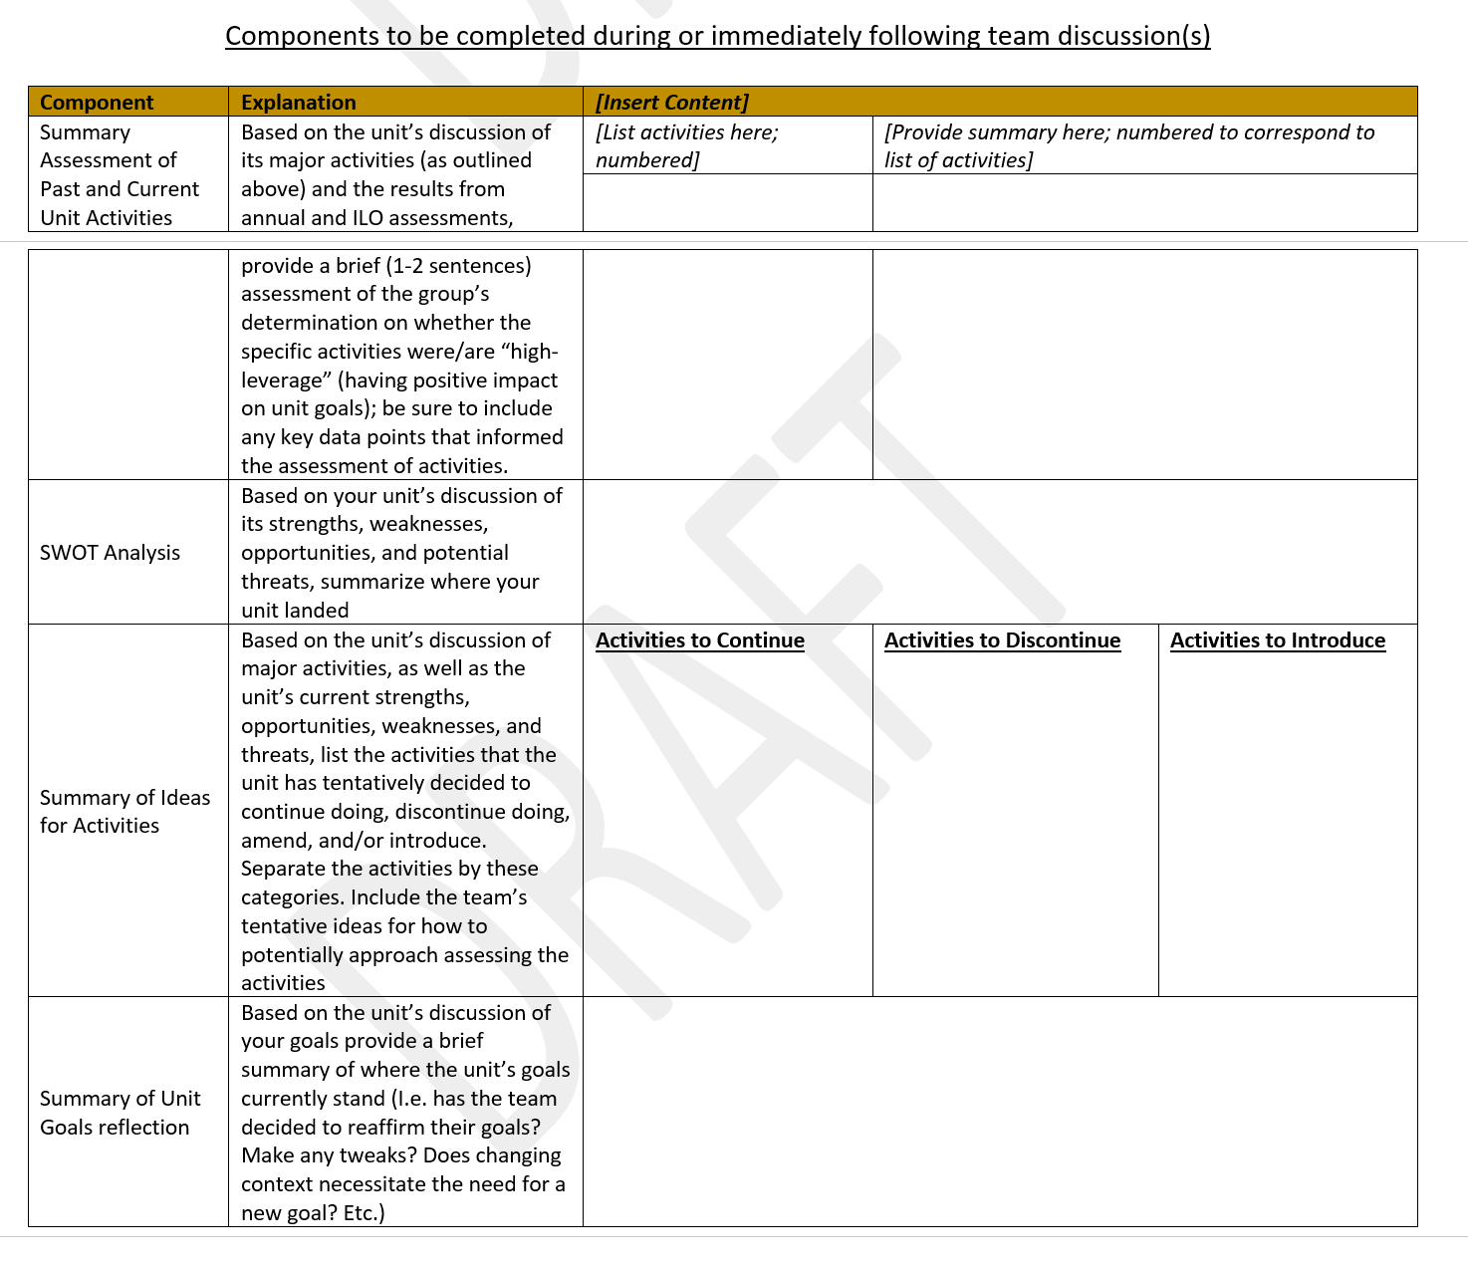

Slide 10
Goals for Completing 2nd Part of Template Document
Summary assessment of past and current activities
Captures where your unit landed with your assessment of the impact of your major activities
Provides a brief statement of what evidence you used to make the determination
E.g. our unit looked at our data related to activity X and realized that the attendance at these events has actually increased over the past few years (by 30%); feedback from exit surveys also seem to suggest that we’re meeting the objectives of the events. We determined this activity is impactful toward our goals.

Slide 11
Goals for Completing 2nd Part of Template Document (cont.)
SWOT Analysis
Strengths and weaknesses listed as part of your SWOT Analysis are internal attributes/characteristics of your unit
E.g. Strength – the members of our unit team have strong organizing skills and capacity; our unit is well-known throughout the college.
E.g. Weakness – our unit has a tendency to get sidetracked from our major projects
Opportunities and Threats listed are external attributes or conditions of your unit

Slide 12
Goals for Completing 2nd Part of Template Document (cont.)
Summary of Ideas for Activities
Contains simple list of which activities the unit will continue, discontinue, and/or introduce based on unit’s assessment
Note: units should carefully consider if there are major activities that it might make sense to discontinue; this is an area that is often short-changed.
If a major activity is going to be continued, but with a substantive change to the approach, that should go in the “Introduce” column.

Slide 13
Goals for Completing 2nd Part of Template Document (cont.)
Summary of Unit Goals Reflection
A brief statement of whether your unit thinks your goals still make sense as is or a statement of any adjustments/edits you think you should make to your unit goals
If your unit thinks an additional unit goal should be included, this should be included.

Slide 14
Pressure-Testing Unit Activities Based on Assessment
Notes:
Go to the Cohort Structure Document

Slide 15
Focus: Summary Assessment of Past and Current Activities
Two volunteers to share one unit activity that your unit assessed
What was the major activity your unit assessed?
What was your unit’s determination on the impact of the activity?
What evidence led your unit to that determination?
The rest of the group ask clarifying questions and discuss:
What did we hear?
What didn’t we hear that might be relevant?
What assumptions might be operating?
Notes:
Group activity – modified consultancy protocol

Slide 16
Approach to Seeking External Feedback

Slide 17
Seeking External Feedback
Goals
Pressure-testing the assumptions and evidence that are informing the unit’s decisions, based on their reflection and assessment;
Uncovering potential blind spots that the unit team may not be aware of
Approach
First – Consider which aspect(s) of your unit team’s assessment would be helpful to have some external perspective (Focus)
Second – use the above to determine from whom it might be most helpful to seek feedback (Relevancy)

Slide 18
Seeking External Feedback (cont.)
Activity (Pairs)
Each partner take turns sharing what aspects of their unit’s assessment they think it would be helpful to seek feedback on:
E.g. “Based on our assessment we determined that there is a new activity we’d like to introduce; would like to get some thought partnership on potential approaches or pitfalls to be aware of”
Then, each partner share who they think it might be most helpful to seek feedback from based on what they’re looking to gain perspective on
In pairs, discuss potential additional ideas for whom to potentially seek feedback from.
Notes:
Don’t need to name specific people; can be general

Slide 19
Share Out

Slide 20
Next Steps
Revise 2nd table of template document and send to Dereck
Develop list of areas for feedback (focus)
Then, determine potential short list of people from whom to seek feedback (relevancy)
Conduct feedback conversation with external entity and compile notes
Prepare for conversation with divisional leadership (More guidance to come!)

Slide 21
Exit Ticket
In the chat, write your response to the following questions:
What do you need as you move through the next phase of this process?
What questions do you still have?

Slide 22
Thank You!

