Slide 1
AES Program Reflection Process - Cohort Meeting #3

Slide 2
Agenda
Time | Agenda Item
2:30 – 2:35 | Welcome and Settling In
2:35 – 2:50 | Debrief external feedback conversations and discussions with divisional leaders
2:50 – 3:00 | Review of guidelines for completing 2nd part of the template document
3:00 – 3:20 | Moving toward “finalization”: adjustments, prioritization, and alignment to college priorities (Pairs)
3:20 – 3:40 | Guidance for finalizing the template and incorporating next steps into annual planning and assessment reporting
3:40 – 3:55 | Celebration of Learning
3:55 – 4:00 | Next Steps

Slide 3
Recording
Notes:
For the purposes of my learning (I will be the sole viewer)

Slide 4
Meeting Objectives
AES Unit Leaders will . . .
Unpack what worked or didn’t with discussions and walk away with lessons learned for the future
Be able to finalize AES PR Template document
Know where and when the finalized document should be housed
Have a strategy for incorporating next steps into the annual planning and assessment reporting template

Slide 5
Debrief Feedback Conversations

Slide 6
Debrief Questions
How was the overall experience?
What was helpful about your feedback conversations?
Did you walk away with what you were looking for? If not, what do you think might have helped?

Slide 7
Review of 2nd Part of Template Document
Notes:
Go to the Cohort Structure Document

Slide 8
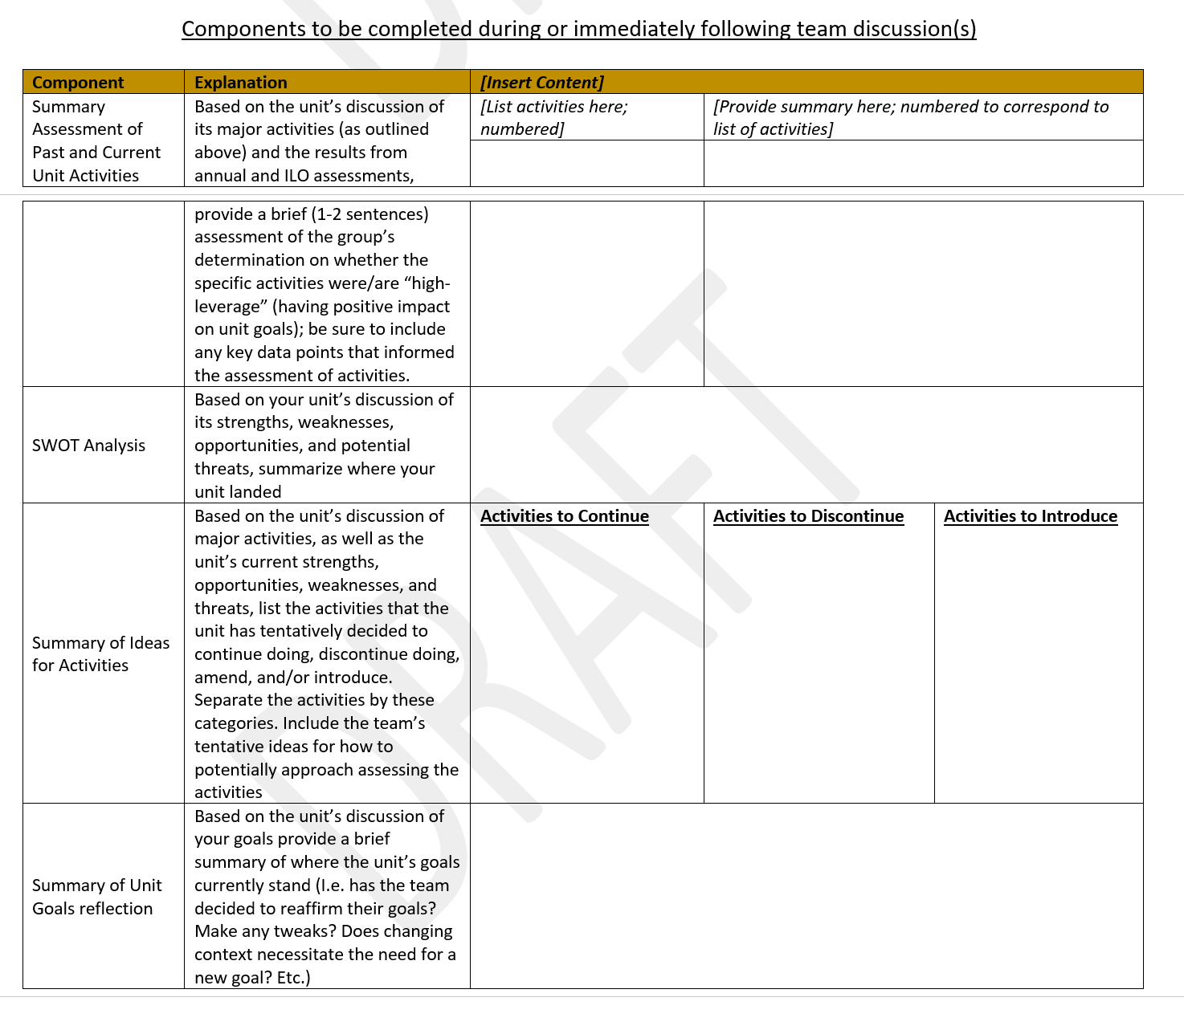

Slide 9
Goals for Completing 2nd Part of Template Document
Summary assessment of past and current activities
Captures where your unit landed with your assessment of the impact of your major activities
Provides a brief statement of what evidence you used to make the determination
E.g. our unit looked at our data related to activity X and realized that the attendance at these events has actually increased over the past few years (by 30%); feedback from exit surveys also seem to suggest that we’re meeting the objectives of the events. We determined this activity is impactful toward our goals.

Slide 10
Goals for Completing 2nd Part of Template Document (cont.)
SWOT Analysis
Strengths and weaknesses listed as part of your SWOT Analysis are internal attributes/characteristics of your unit
E.g. Strength – the members of our unit team have strong organizing skills and capacity; our unit is well-known throughout the college.
E.g. Weakness – our unit has a tendency to get sidetracked from our major projects
Opportunities and Threats listed are external attributes or conditions of your unit

Slide 11
Goals for Completing 2nd Part of Template Document (cont.)
Summary of Ideas for Activities
Contains simple list of which activities the unit will continue, discontinue, and/or introduce based on unit’s assessment
Note: units should carefully consider if there are major activities that it might make sense to discontinue; this is an area that is often short-changed.
If a major activity is going to be continued, but with a substantive change to the approach, that should go in the “Introduce” column.

Slide 12
Goals for Completing 2nd Part of Template Document (cont.)
Summary of Unit Goals Reflection
A brief statement of whether your unit thinks your goals still make sense as is or a statement of any adjustments/edits you think you should make to your unit goals
If your unit thinks an additional unit goal should be included, this should be included.

Slide 13
“Finalization”: Adjustments, Prioritization, and Alignment to College Priorities

Slide 15
Objectives for Finalizing
Adjusting plans based on feedback and new information
This include considering what we may discontinue or change
Prioritizing what we think is going to be most impactful toward our goals
Being conscious of our individual and team bandwidth
"If everything is important, then nothing is." ― Patrick Lencioni
Considering how our activities are aligned with, or could support, college-wide priorities (connected to prioritizing)
Ask: “Where can my unit’s proposed activities from this process support one or more priority?”
Notes:
“If everything is important, nothing is important”
Priorities management: https://www.workfront.com/project-management/knowledge-areas/time-management/priorities-management
https://www.wework.com/ideas/worklife/how-to-prioritize-work

Slide 16
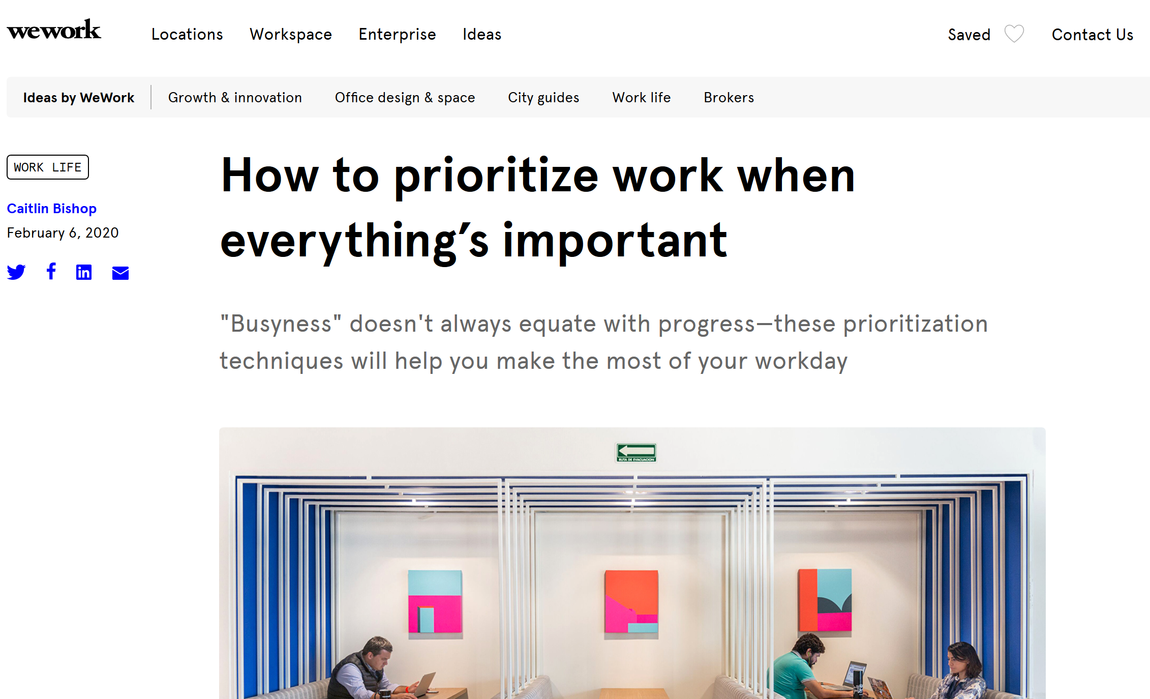

Slide 17
Notes:
https://www.hostos.cuny.edu/Hostos/media/Office-of-the-President/Strategic%20Plan/Hostos-2017-2022-Strategic-Plan-Framework-Booklet.pdf

Slide 18
Activity
In pairs/trios, take turns discussing the following questions
What one thing is our unit adding, changing, or discontinuing as a result of this process?
Which of the college-wide priorities speaks most closely to the work of our unit and which activity(ies) most closely align with that.
What is our unit going to be prioritizing this year and next?

Slide 19
Last Part of Template and Incorporating into Annual Planning and Assessment Report

Slide 21
Guidance for Last Table
Updated Major Unit Activities
Simple bulleted list of all the major activities that the unit has decided on based on the process (continuing ones and new/changed ones)
Discontinued activities should not show up in this list
On the column to the right, for each activity list approximately what AY your unit plans to engage in it (e.g. AY20-21; AY21-22)
Roles and Responsibilities
M.O.C.H.A. Framework to help determine role clarity
Consider if any of the activities requires collaboration somewhere else in the college and flag that in the template
Notes:
Note: not all of the activities may be pursued this year and they don’t have to be
MOCHA Framework - https://www.managementcenter.org/wp-content/uploads/2015/08/MOCHA-for-managers.pdf

Slide 23
Connection to Annual Report
Activities that you flagged in the last part of the table as taking place for AY20-21 should be reflected in this year’s Annual Planning and Assessment Reporting Template Draft (“Activities” column of Table 1)
Notes:
Don’t need to name specific people; can be general

Slide 25
Celebration of Learning

Slide 26
2020
2021
Aug
Sep
Oct
Nov
Dec
Jan
2021
Today
Aug 1 - Sep 1
Finalization of Process
Intro to AES PR Process
Introduction of Redesigned Process to AES Unit Leaders
Sep 3
AES Pr Process Webinar to College
Sep 22
First Introduction to AY20-21 Cohort
Sep 9
2020
First Cohort Meeting
Engagement in Process
Sep 29
Phase 1 - Review of Information and Reflection
Sep 29 - Nov 4
Second Cohort Meeting
Nov 5
Phase 2 - External Feedback
Nov 5 - Dec 18
Last Cohort Meeting
Wrapping Up Process
Dec 15
Final Submission
Jan 8

Slide 27
Reflection and Learning
What one key thing did you learn about your unit throughout this process?

Slide 28
Next Steps
Have your final conversations (if not yet done)
Dereck to share final guidance by end of December
Final template due to Dereck by January 8th, 2021
Completed templates will be shared with Institutional Effectiveness Committee (IEC) and Divisional VPs
College-wide sharing/celebration of summary learnings from the process (end of January)
Dereck will reach back out to cohort for suggestions/ideas

Slide 29
Thank You!

